Slide 1
JSP JAVA Server Pages

Slide 2
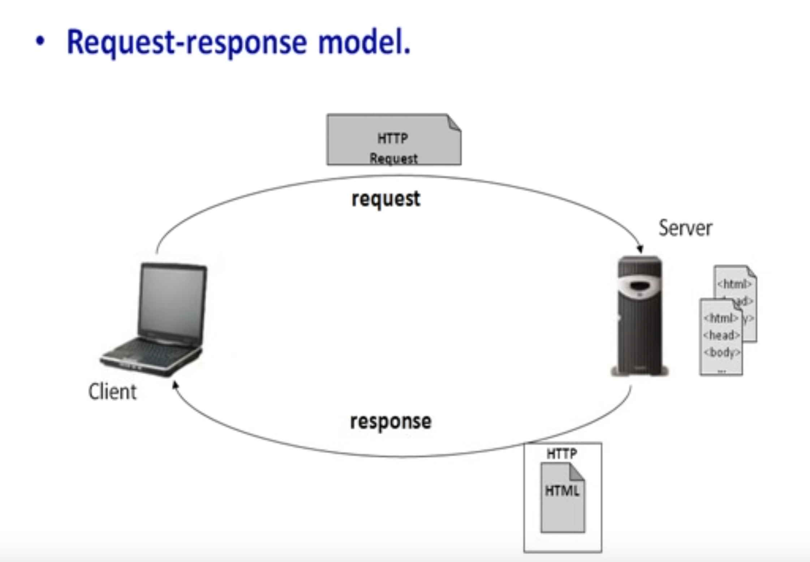
Introduction
Request-Response Model

Slide 3
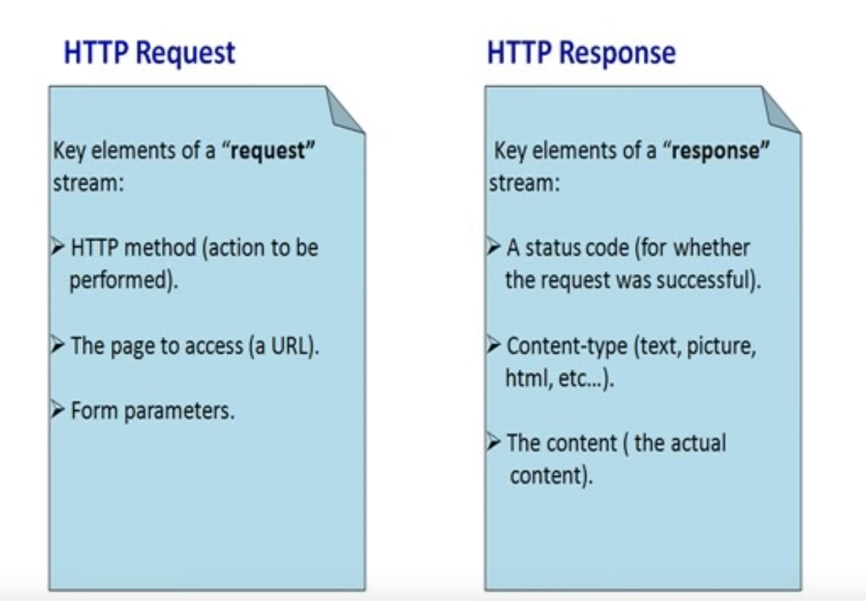
Introduction
What is a request and a response

Slide 4
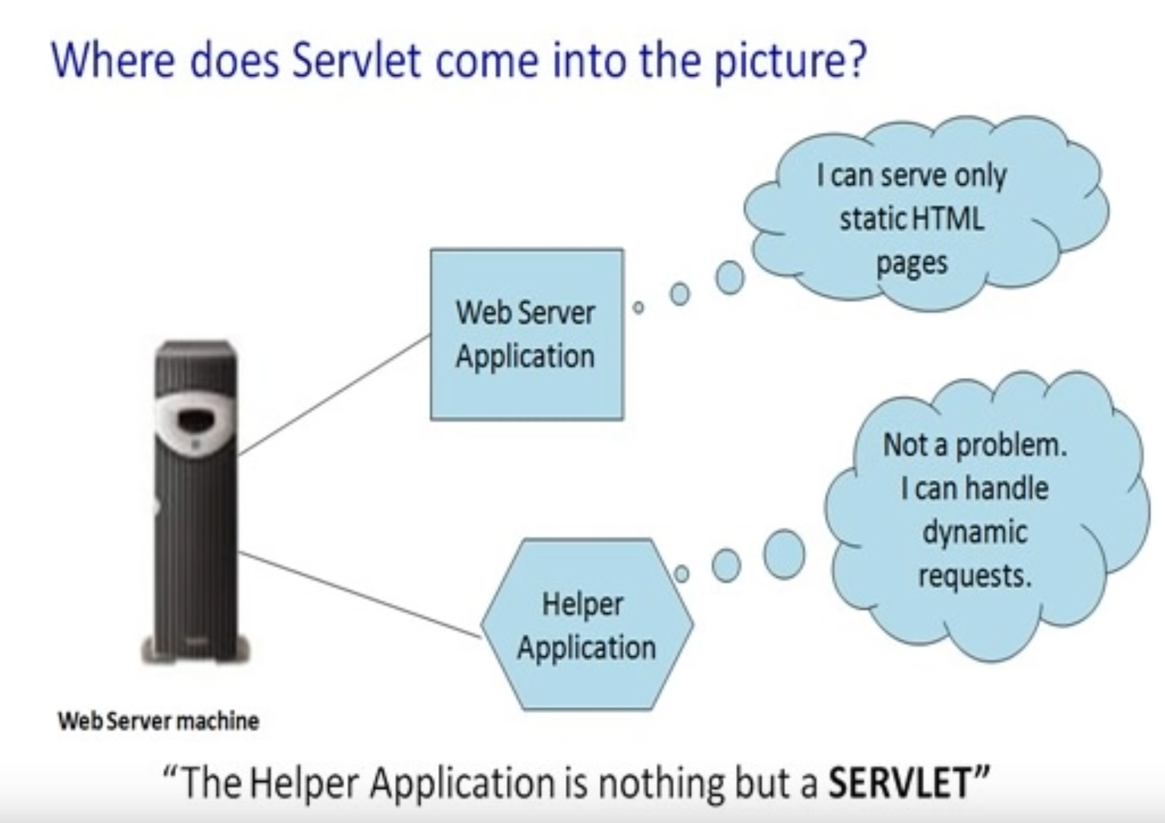
Servlets
What is a Servlet

Slide 5
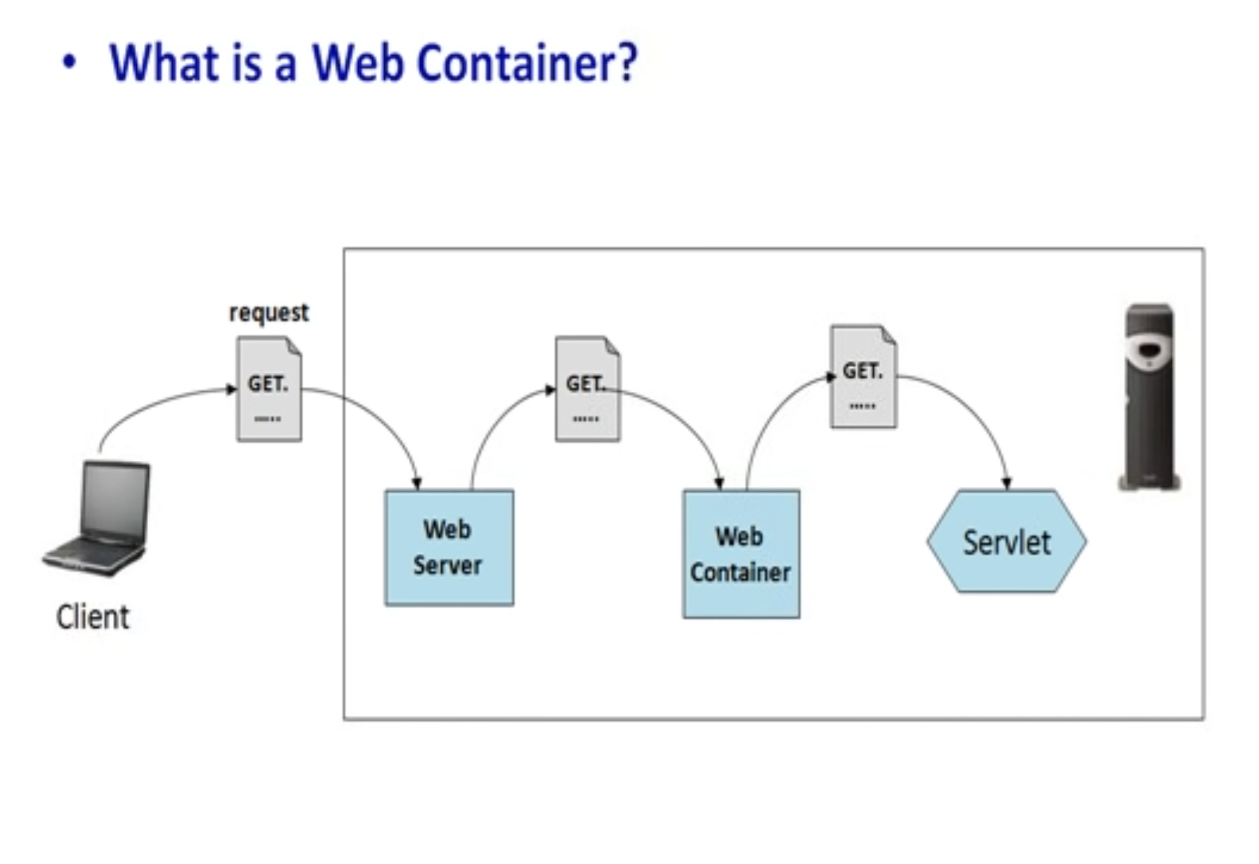
Servlet Architecture
Web Container

Slide 6
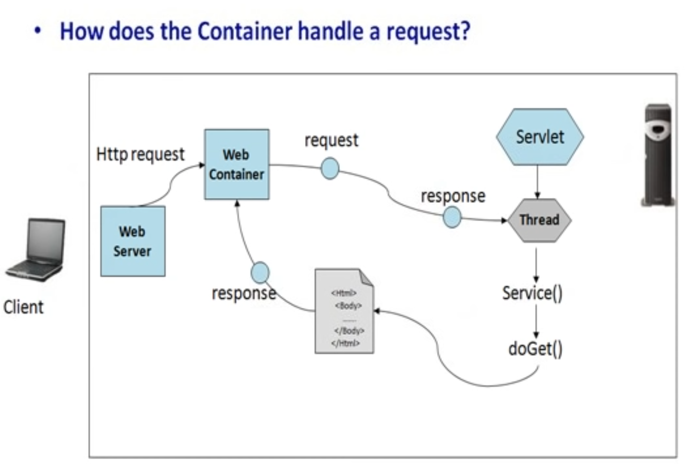
Servlet Architecture
Web Container

Slide 7
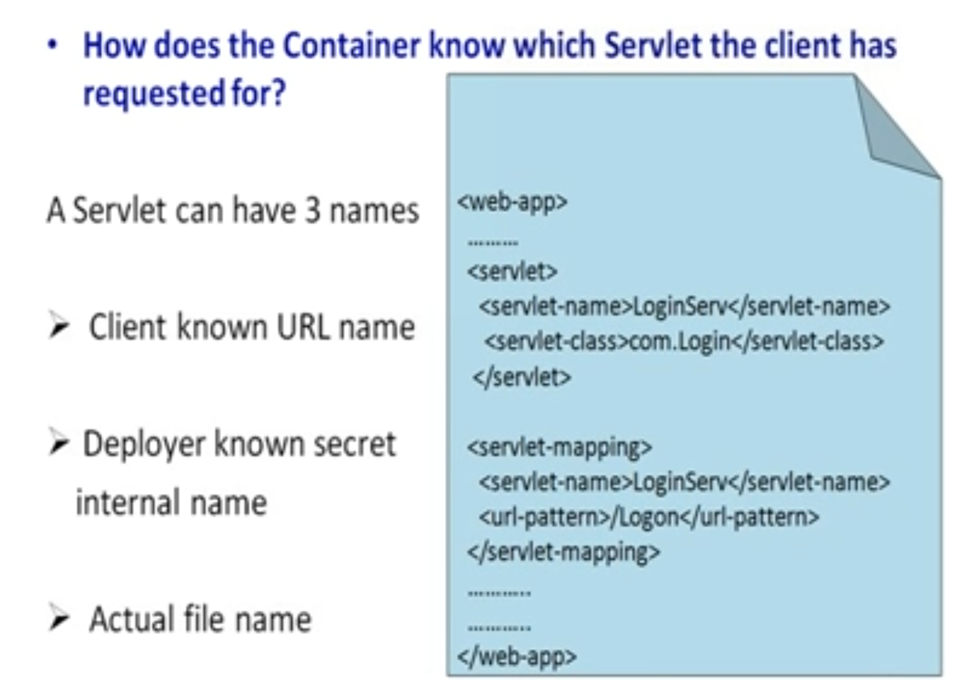
Servlet Architecture
Deployment Descriptor

Slide 8
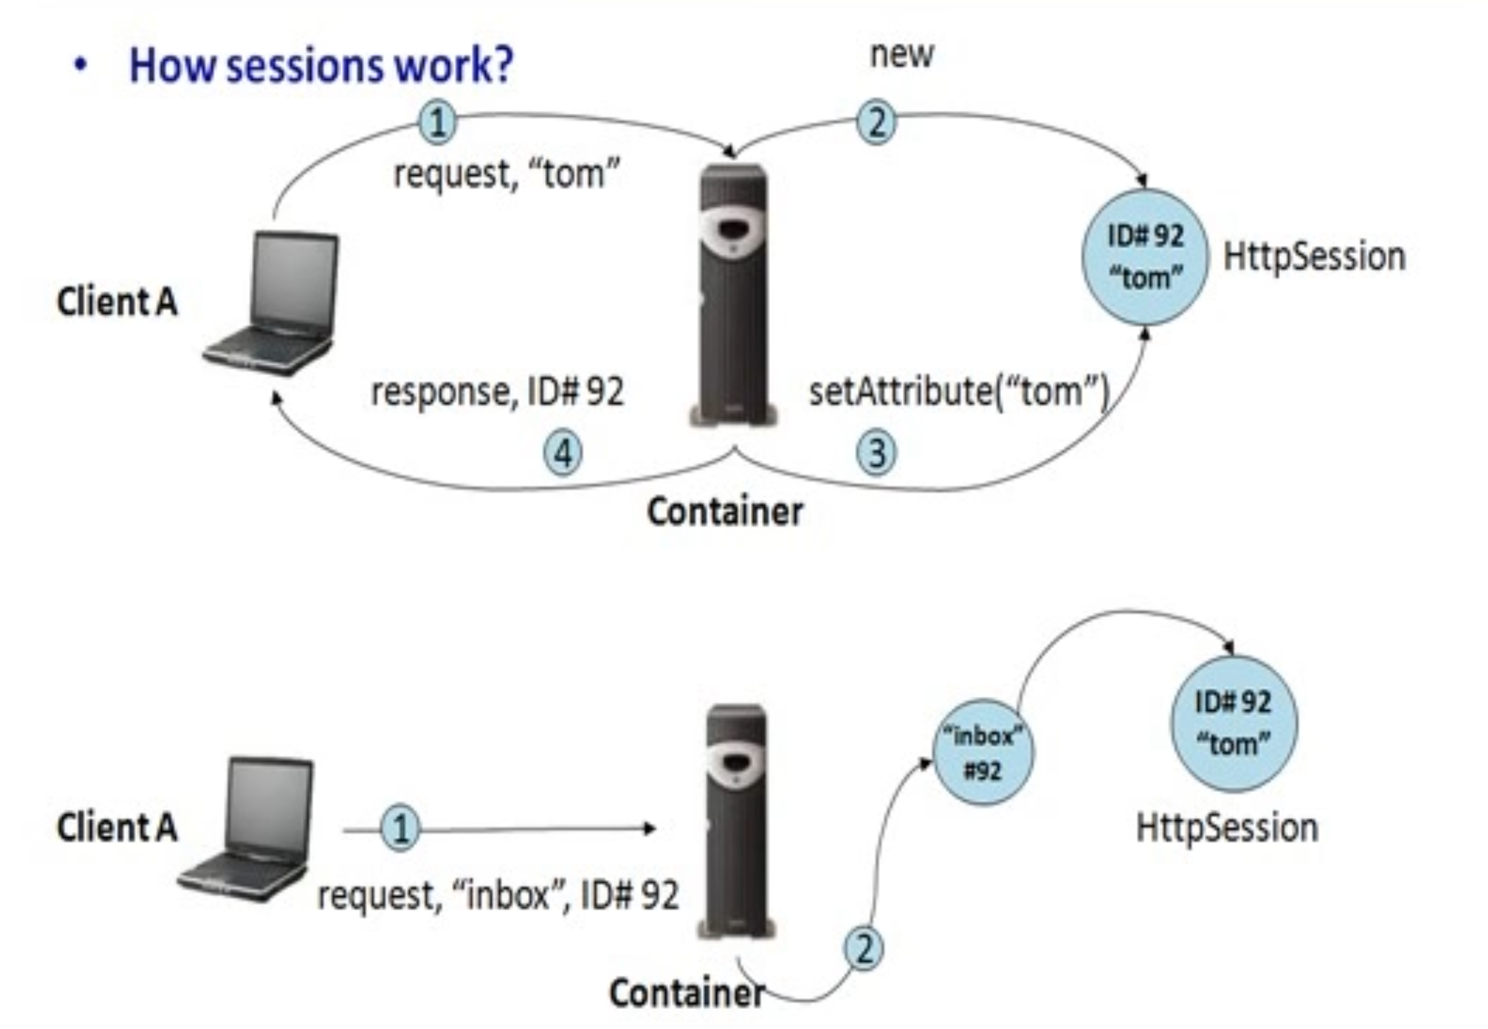
Session Management
Session Tracking

Slide 9
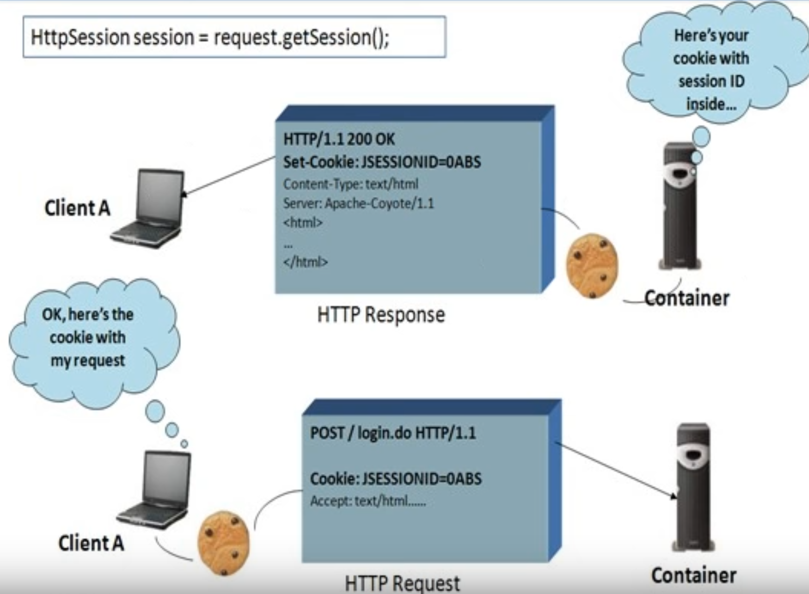
Session Tracking
Cookies

Slide 10
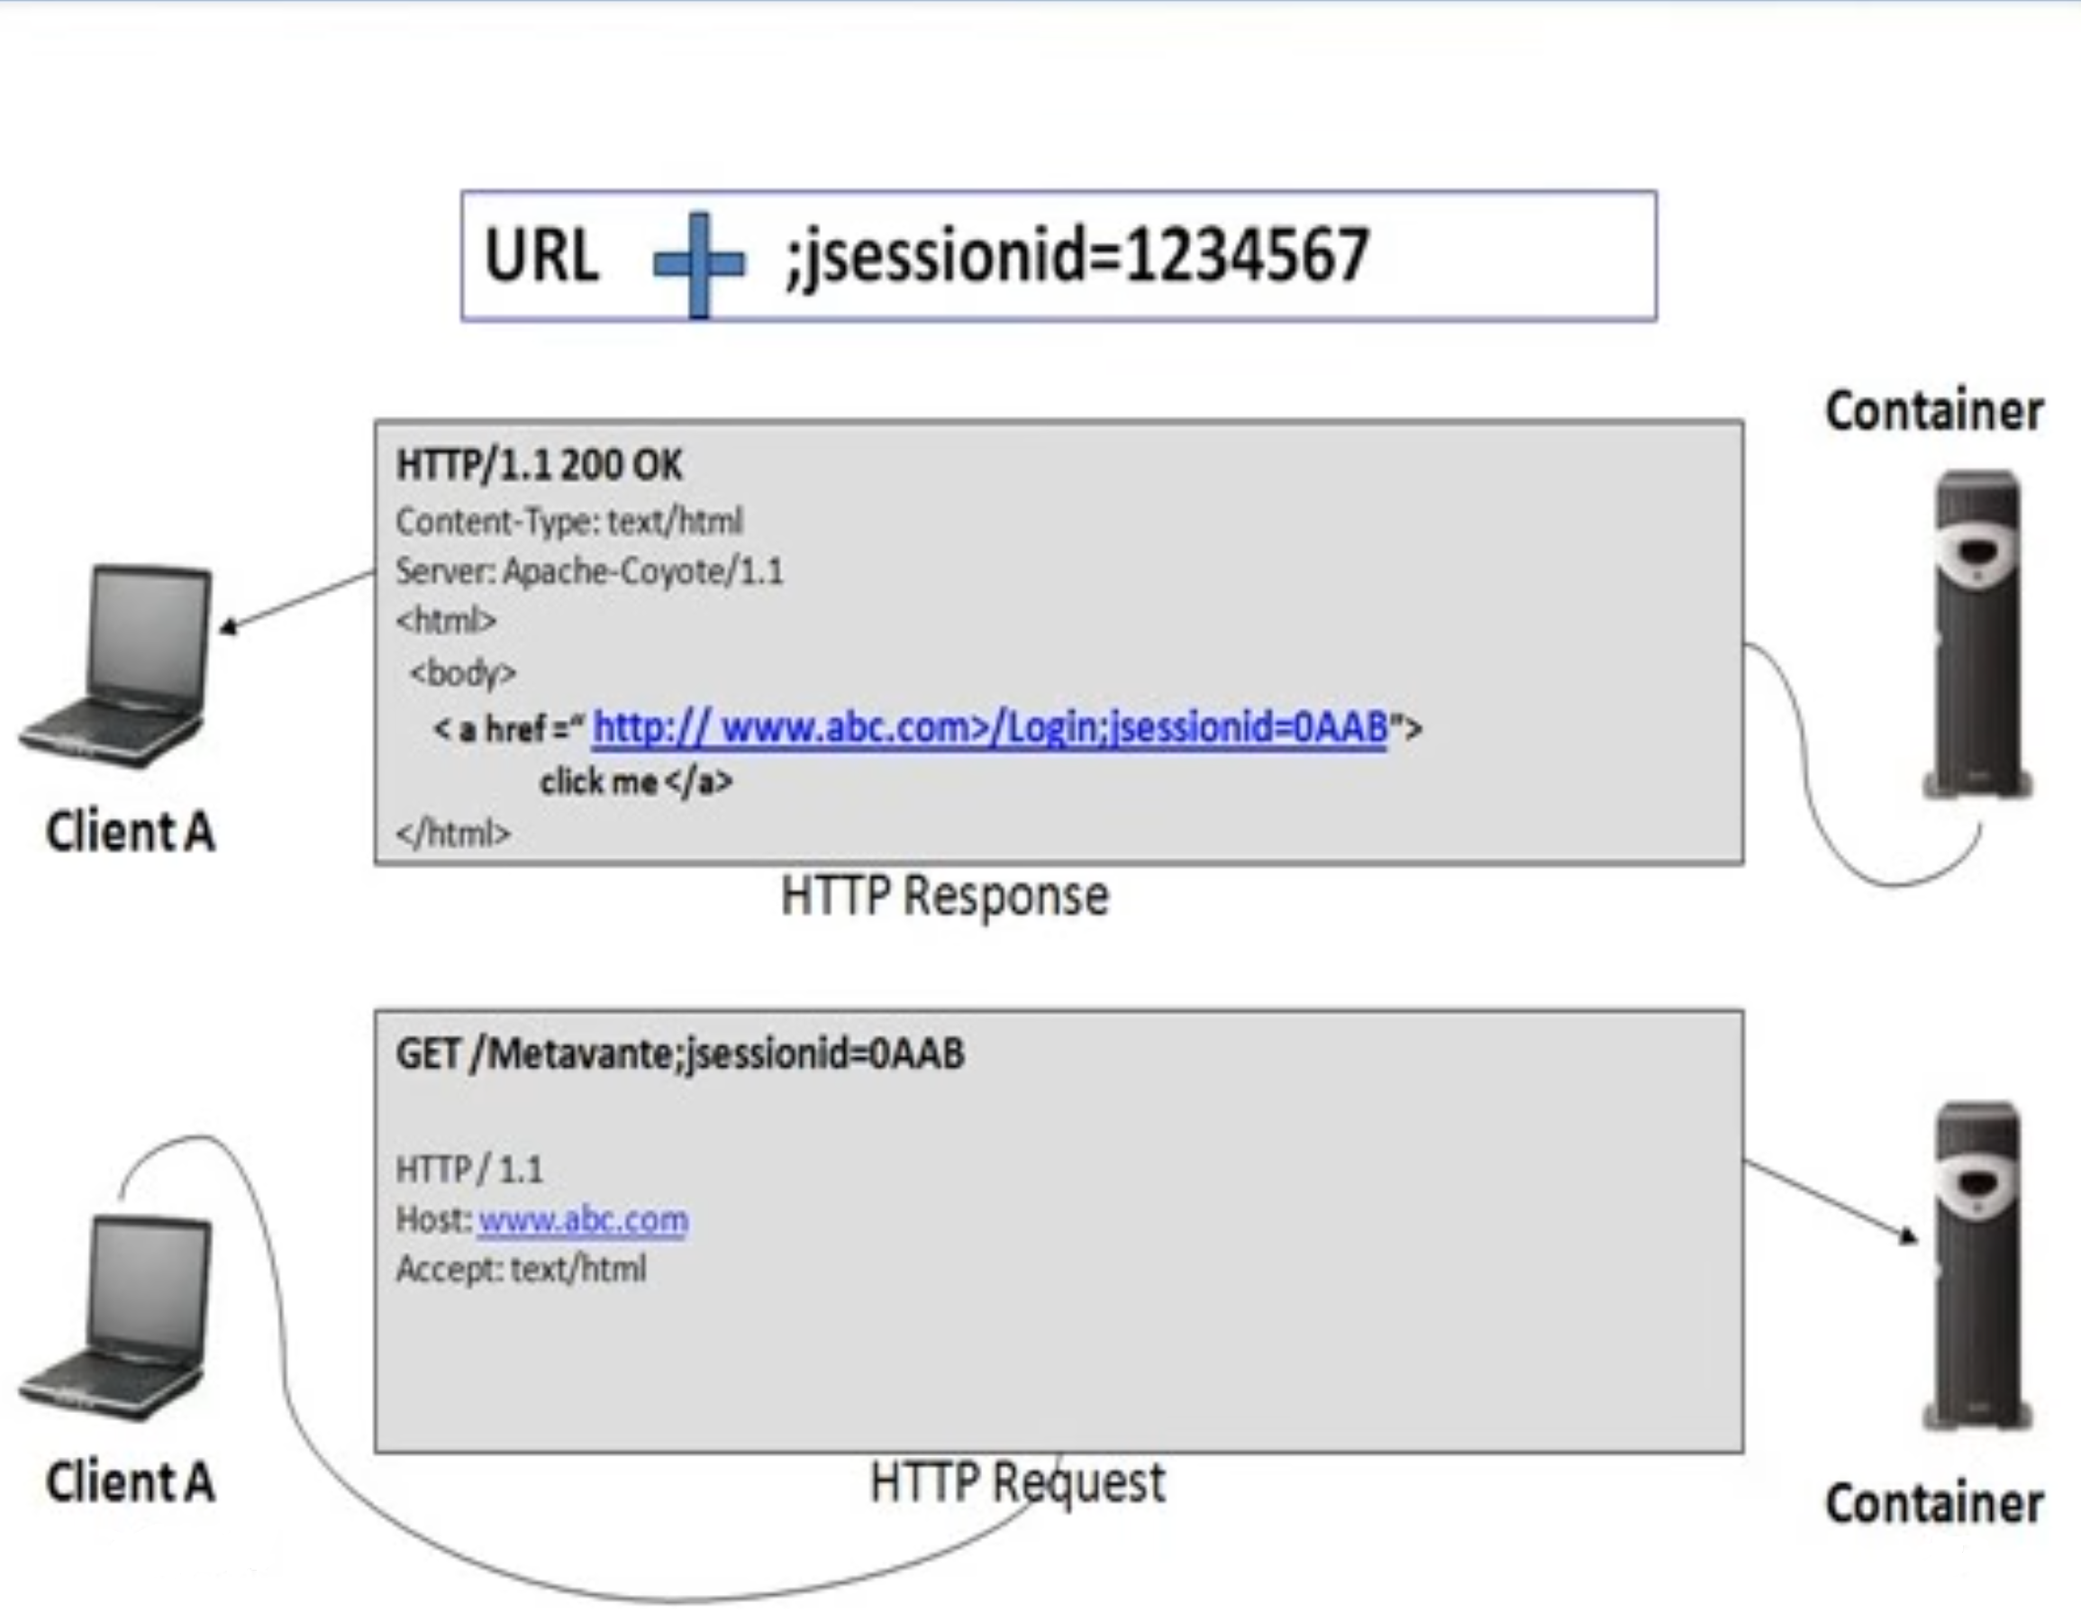
Session Tracking
URL Rewriting

Slide 11
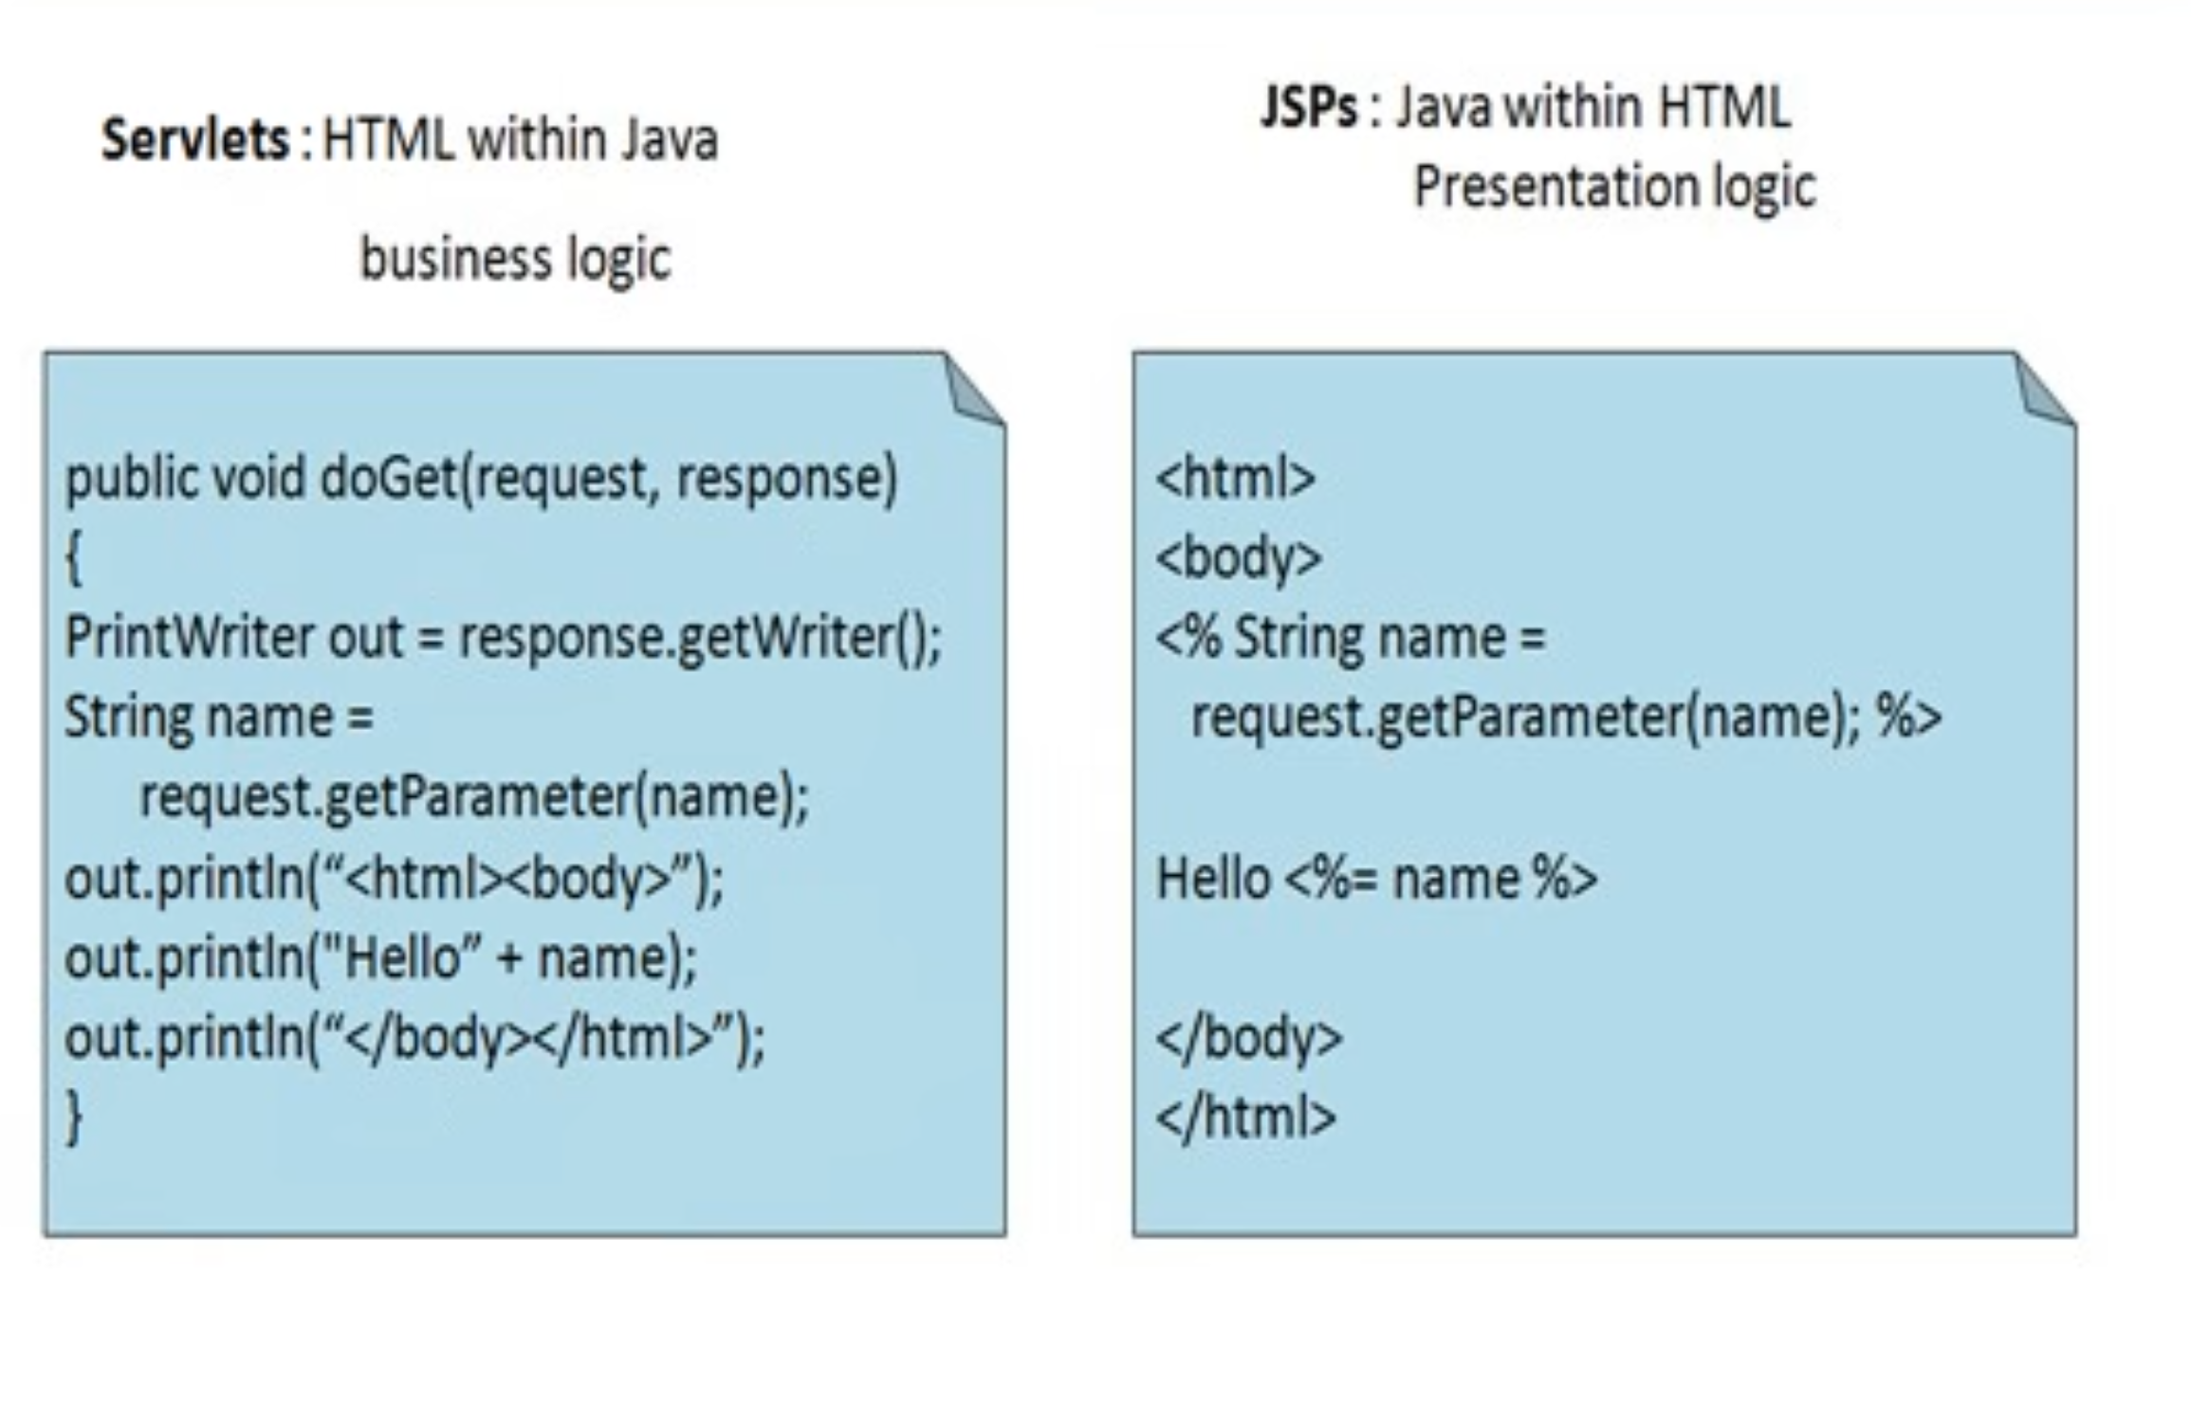
JSP Overview
Servlets v/s JSPs

Slide 12
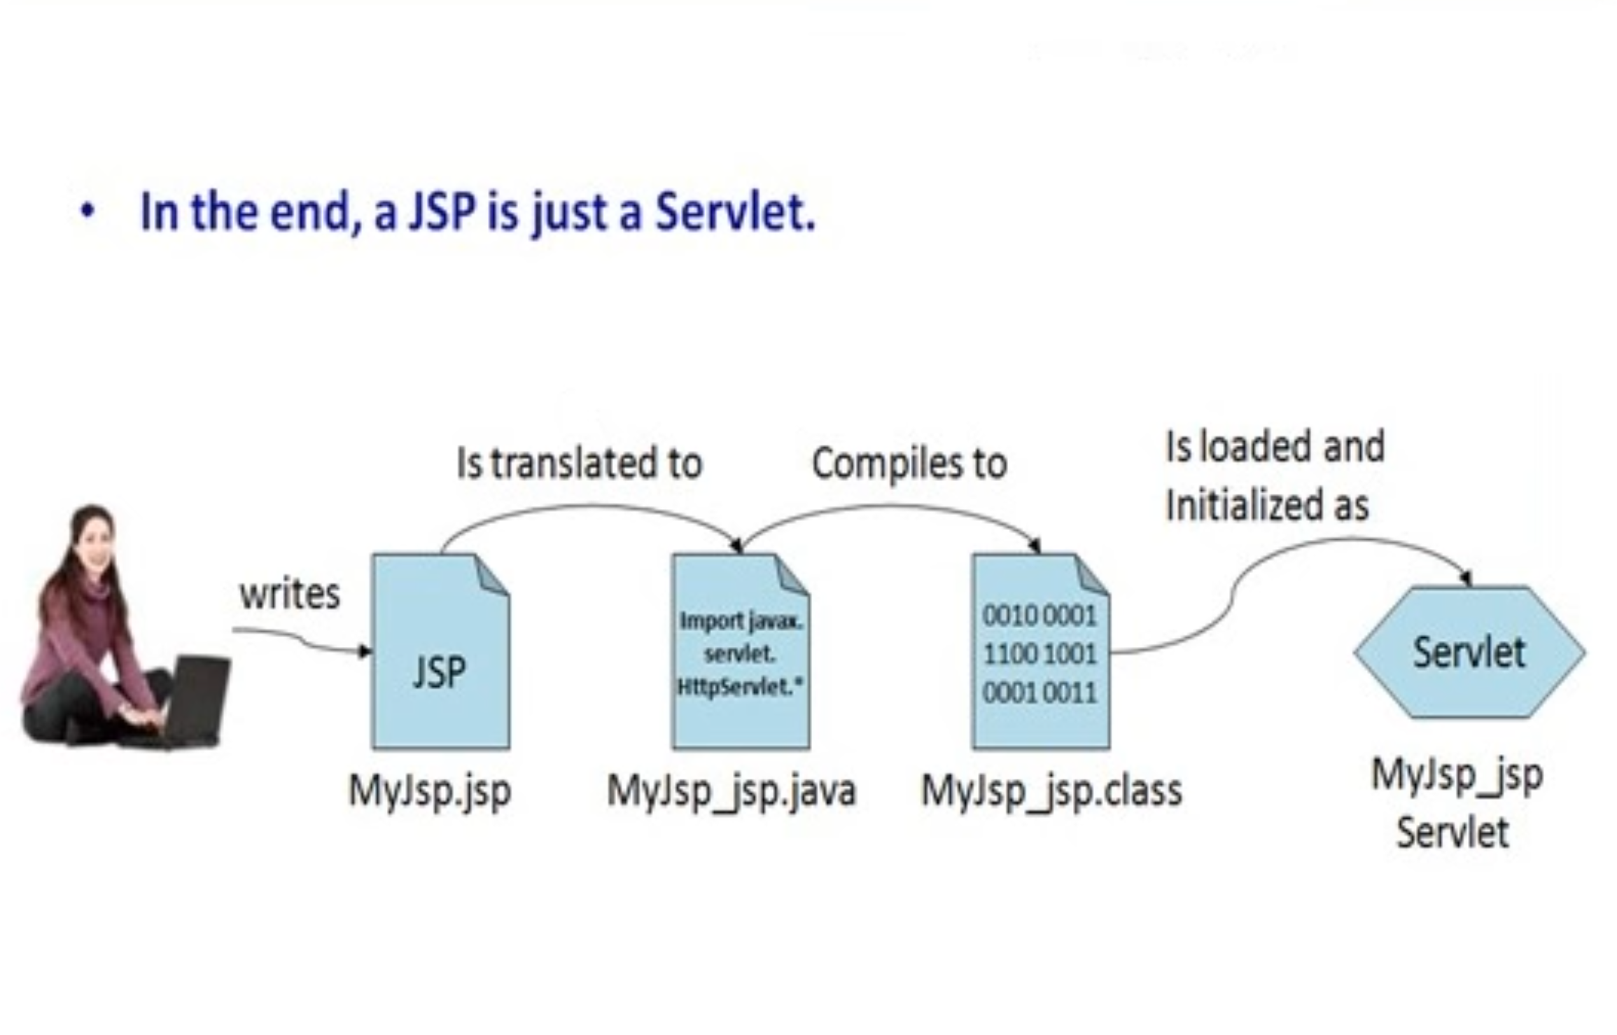
JSP Overview
What is a JSP

Slide 13
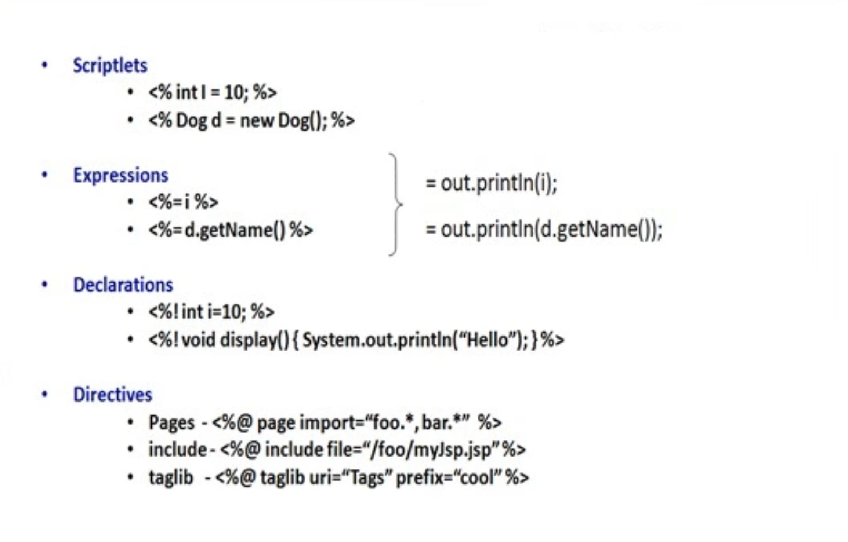
JSP Elements

Slide 14
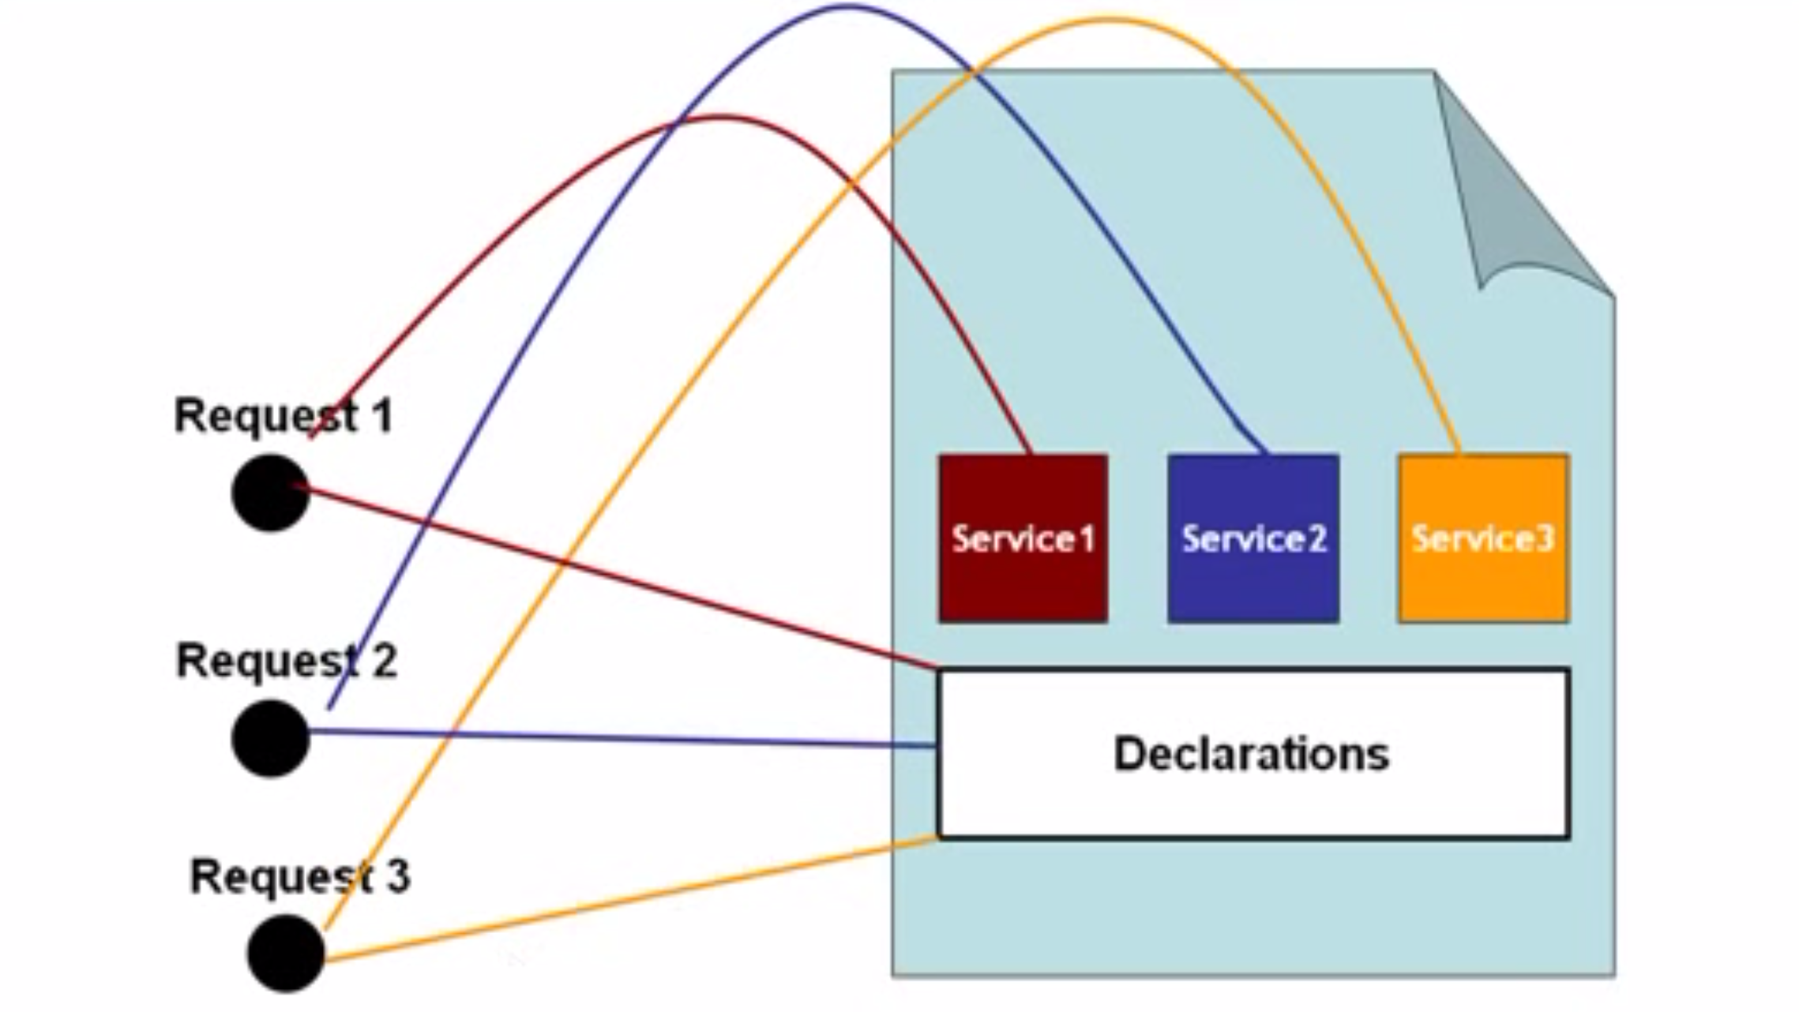
Declarations

Slide 15
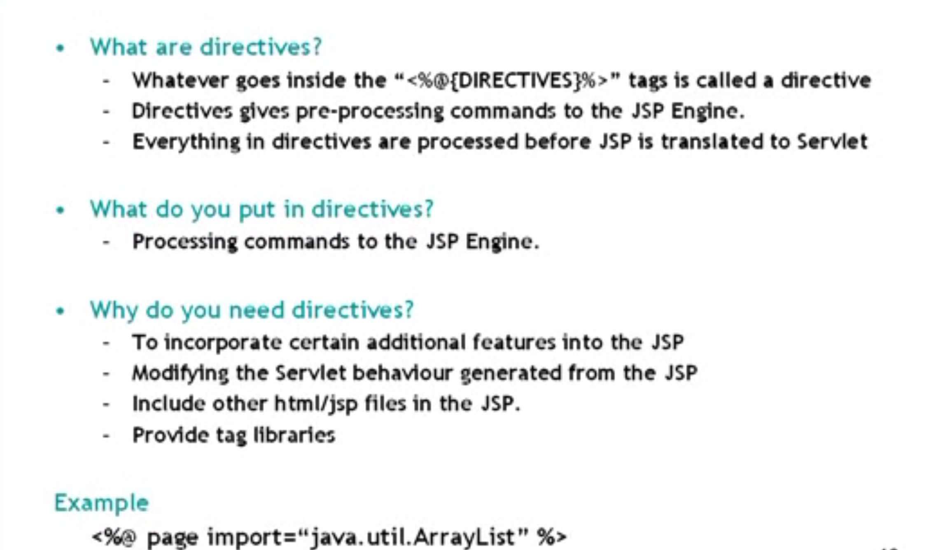
Directives

Slide 16
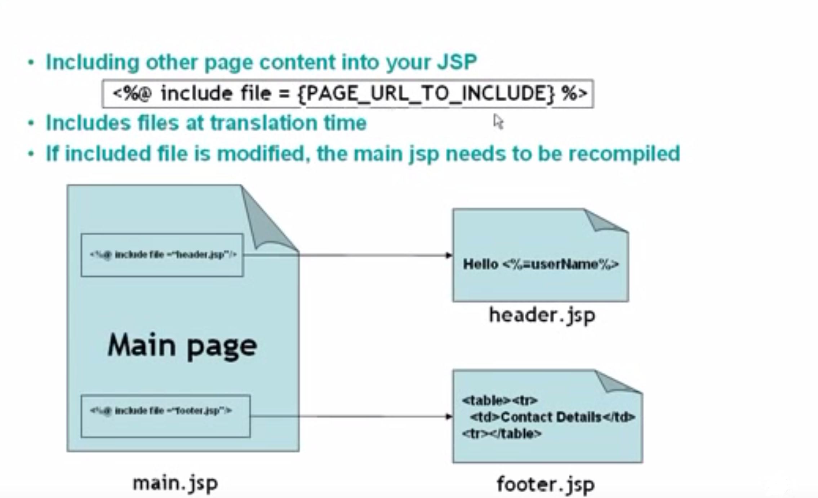
Include Directive

Slide 17
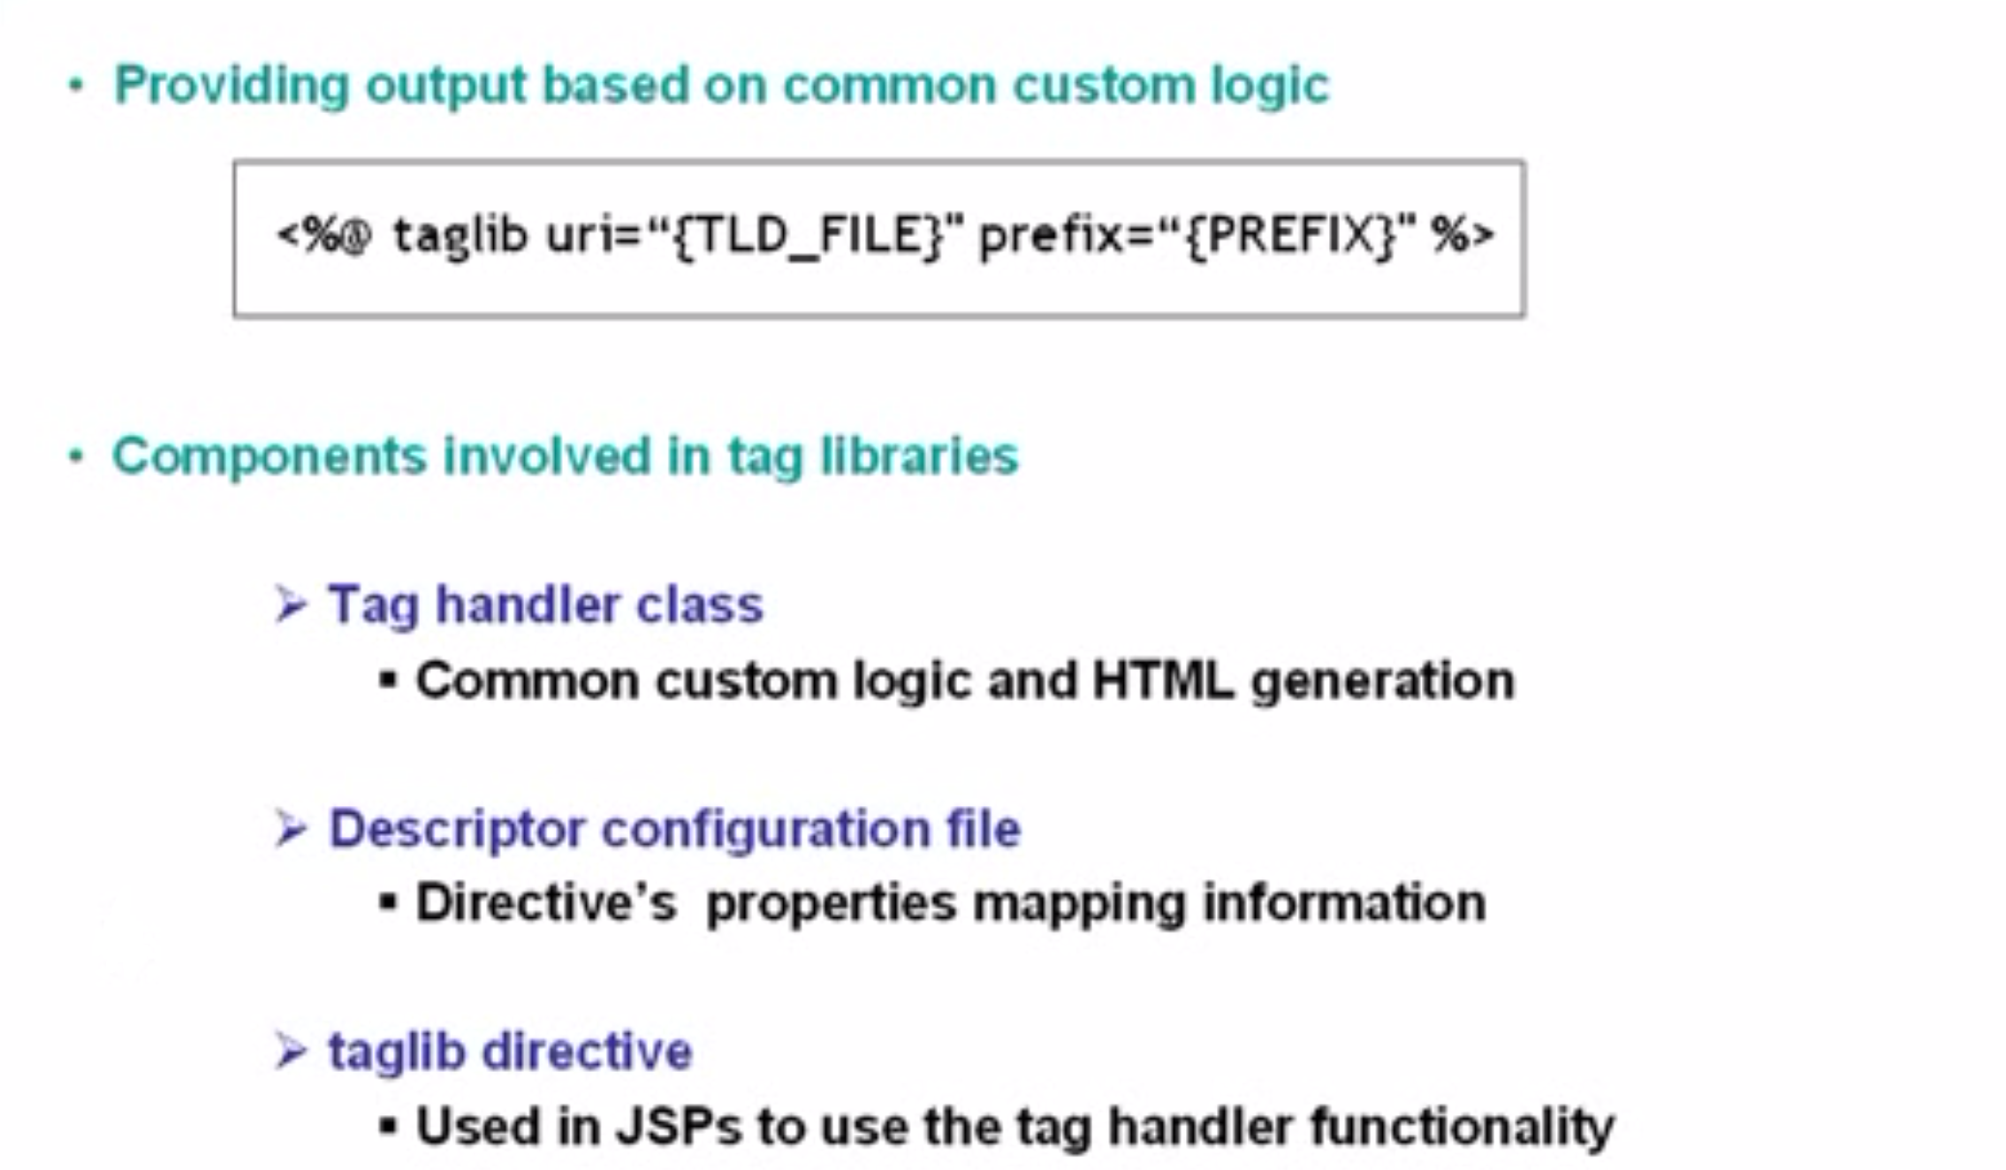
Taglib Directive

Slide 18
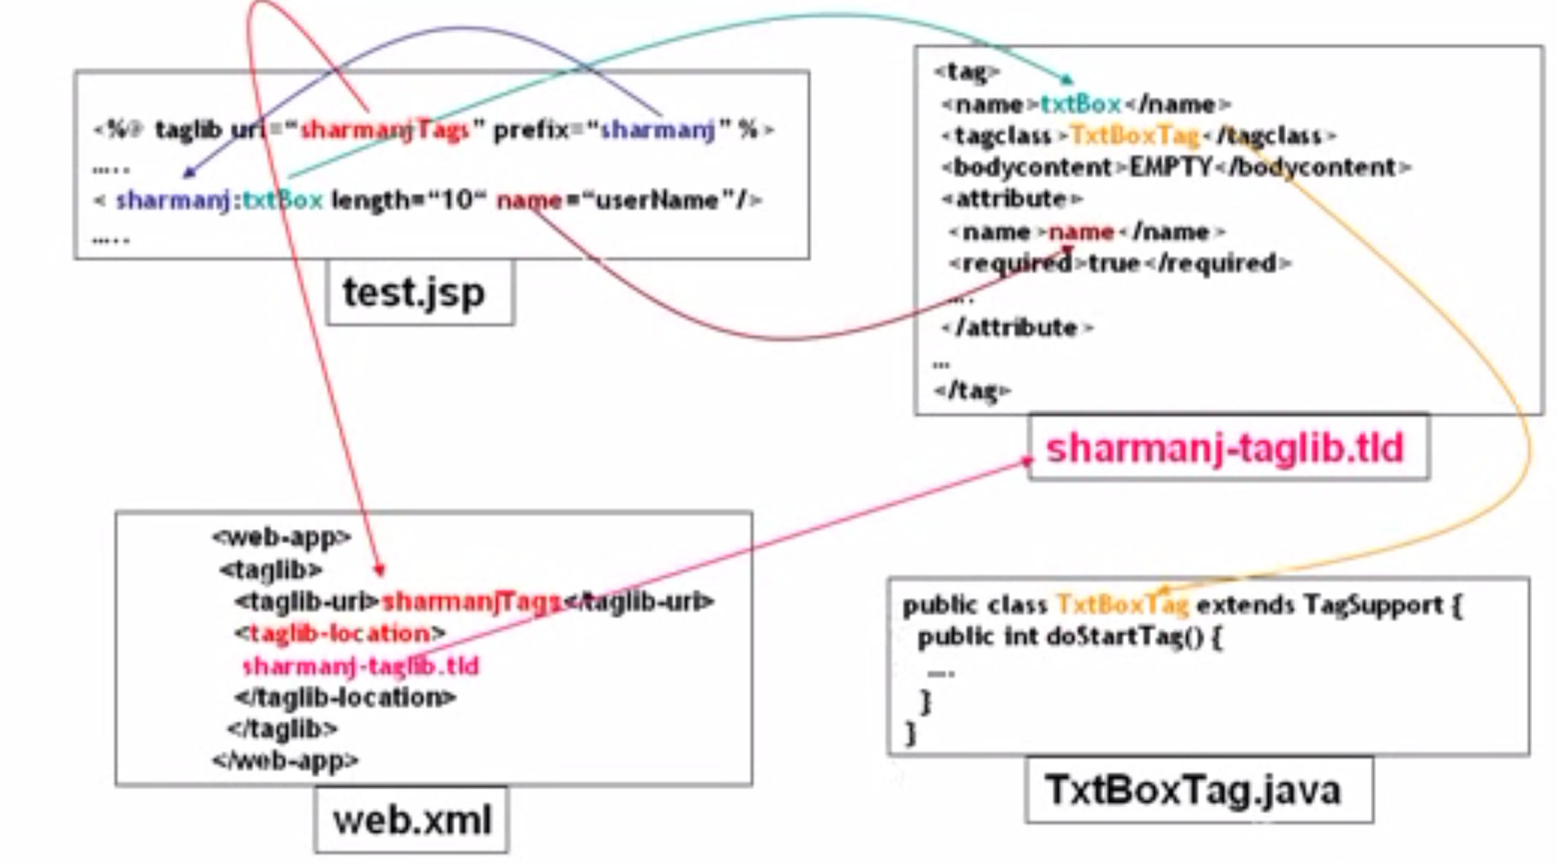
Taglib Directive

Slide 19
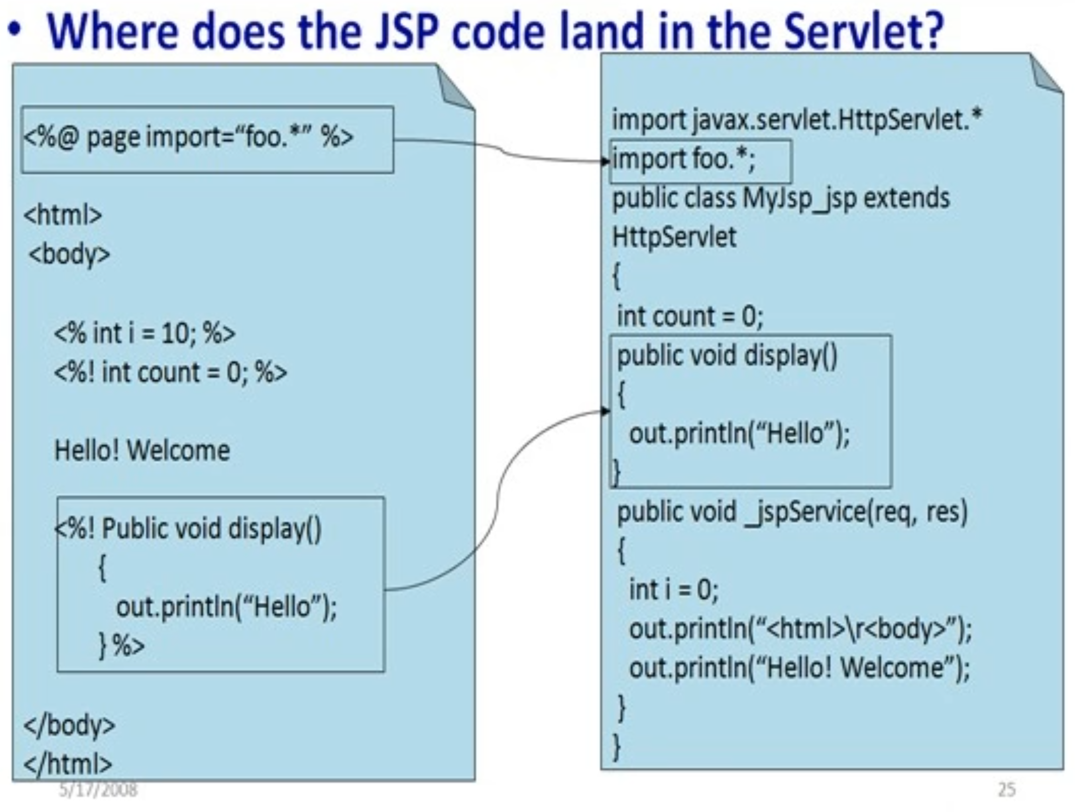
JSP Elements
JSP to Servlets

Slide 20
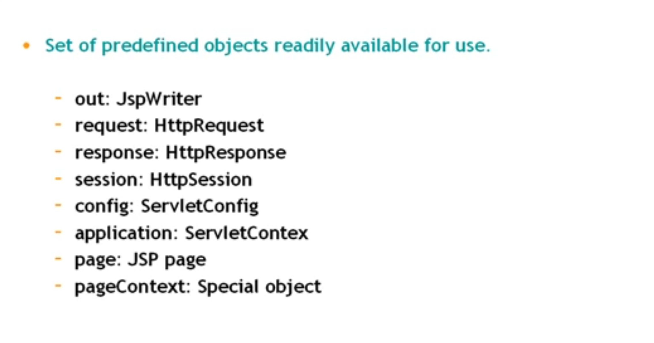
Implicit Objects

Slide 21
Demo

